Slide 1
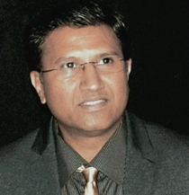
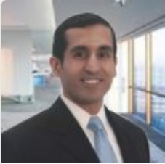
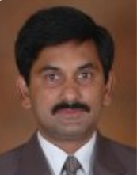
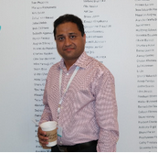

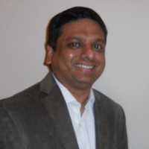

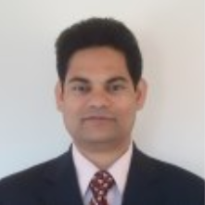
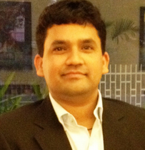
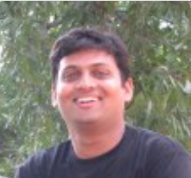
Meet The IBM Leadership Team
Murali Sundararaju
Delivery Project Executive
Mobile +91 98860 38613
msundara@in.ibm.com
Sanjay Nagrani
Account Partner
Mobile +1434 825 0049 nagrani@us.ibm.com
Omsumanth B Shivashankar
Service Delivery Manager CRM
Mobile +91 98457 10434
omsumanth@in.ibm.com
Subodh Agarwal
Project Executive
Mobile : +1 240 672 4321
asubodh@in.ibm.com
Pooja Gundecha
Service Delivery Manager PMS
Mobile +91 98234 17101
Pooja.gundecha@in.ibm.com
Prakash Gupta
Service Delivery Manager CRM
Mobile : +1 609 6511867 prakashg@us.ibm.com
Sandhya MS
Project Management Office
Mobile +91 97416 64980
sandhms2@in.ibm.com
Nilesh Gangakhedkar
Service Delivery Manager PMS
Mobile +1 316 258 2964
nilesh.gangakhedkar@in.ibm.com
Sujit Pati
Program Manager Automation
Mobile : +1 908 848 1537
Sujipati@in.ibm.com
Sandip Andhale
Program Manager Build
Mobile +1 240 383 2233
sandhale@in.ibm.com

